Slide 1

One Semi-Supervised Method for
Entity Type Prediction
Team Name: CBrain. Final Result: Second-Place (0.98435)
Member: Jiaming Xu, Suncong Zheng, Boxu, Guanhua Tian
Reporter: Suncong Zheng
JIST2015 Challenge, 2015/11/11.
Institute of Automation, Chinese Academy of Sciences

Slide 2
Content
1
Introduction
2
Data Analysis
3
Feature Extraction
4
Model Training
5
Experiments

Slide 3
Introduction
Task Description:
1897 URLs are provided and 1397 of them are provided with label information. The task is the classification of the 500 unlabeled URLs.
Data Description:
Labels: There are 10 labels: insect, university, game , politician, city, song, novel, scene, cartoon, actor.
URLs: Each URL contains four kinds of information: Abstracts (textual
data) , Infobox data (structured data), External URLs and Related URLs.

Slide 4
Data Analysis
Example:
URL: http://zhishi.me/baidubaike/resource/%FF%FE%4E%53%0F%59%61%21
Label: game
Abstracts: “《华夏Ⅱ》是一款由深圳网域公司开发的3D 网络游戏。该游戏以神、人、魔、幽冥四界之间的纷争和有情世间的恩怨情仇为主线，再现了《山海经》、《淮南子》等古书中记载的传奇故事，充分体验到华夏民族的创造力和想象力 ”。
Infobox data:
Analysis :
The first sentence of abstract contains important information of entity type.
The first sentence sometimes contains the pattern: “[entity] is [type]”
The attribute type and attribute value in infobox are related to the entity type.

Slide 5
Feature Extraction
The feature of abstract (L1)
Filter special characters
Chinese words segment
Filter stop words
Compute the TF-IDF of the abstract
plus Infobox feature (L2)
The attribute type and attribute value in infobox are treated as words.
Compute the TF-IDF of the “attribute words”,
The feature of the first sentence in abstract (L3 & L4)
The TF-IDF features as L1 does, which called L3.
The 1-gram segment feature called L4.

Slide 6
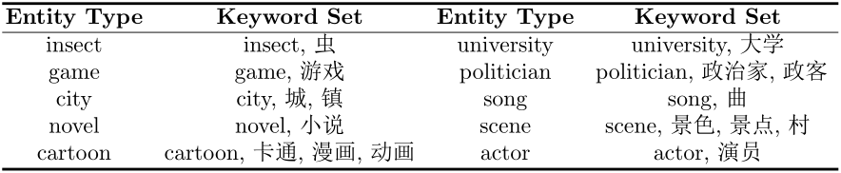


Feature Extraction (Pattern Extraction)
Pattern :
Format of template: “is [wi] [word_1 word_2 … word_n].” Where wi is the key words of entity type i and n is the distance between the key word wi and the sentence’s end. We just match the first k sentences in abstract.
The key-words set of all types:
The feature vector based on template is where
M is the number of entity type.
If the first sentence x of abstract contains the Template 1, f(x, wi) = 1.

Slide 7


Model Training
Pre-training
X: Represent the semantic vectors (X) of URLS based on the features: L1, L2,L3,L4
Y: Train the linear SVM classification and obtain the type probability distribution of each URL on test set.
Fine-tuning
Modify the type probability by considering the Pattern feature Q:
Re-training :
If the predict results of a given URL on test set satisfies the following condition, we add it to the training set to retrain the model:
Where is the maximal value of $\hat{Y} and is the \text{second} \text{largest} \text{value} \text{of} \hat{Y.}$

Slide 8
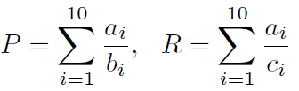

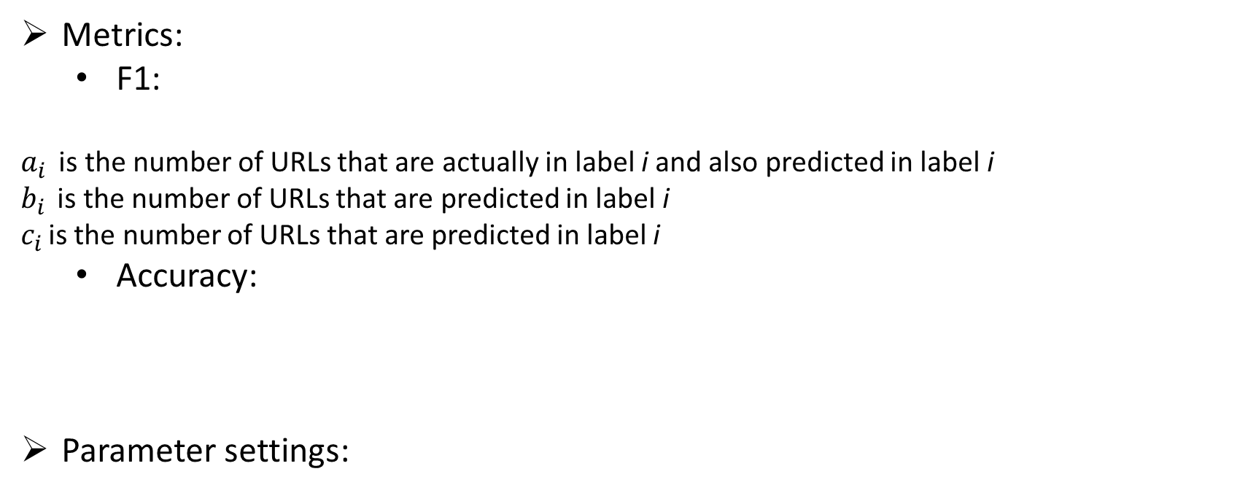
Experiments
Metrics:
F1:
$a_{i }$ is the number of URLs that are actually in label i and also predicted in label i
$b_{i }$ is the number of URLs that are predicted in label i
$c_{i }$is the number of URLs that are predicted in label i
Accuracy:
Parameter settings:
k | l
3 | 3 | 3 | 0.2

Slide 9
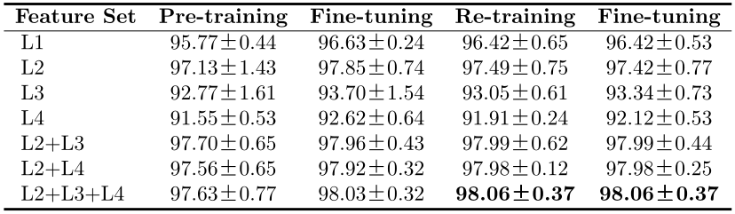
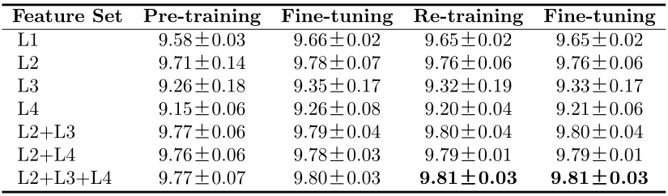
Experiments
Results:
Accuracy:
F1:

Slide 10
Thank you!
Q/A
10
Notes:
Thank you so much for your attention.

